Slide 1




NEXT GEN EMPLOYABILITY PROGRAM
Creating a future-ready workforce
Team Members
College Name
Student Name : Nisha J
Student ID : 511321104063
Kingston Engineering College

Slide 2

CAPSTONE PROJECT SHOWCASE
Project Title
Building Bus Reservation System using Python and Django
Abstract | Problem Statement | Project Overview | Proposed Solution | Technology Used | Modelling & Results | Conclusion

Slide 3
Abstract
This project introduces a Bus Reservation System (BRS) created using Python and Django.
The system enables easy online booking, modification, and cancellation of bus tickets for passengers.
It incorporates user authentication, seat selection, secure payment processing, and administrative tools for managing buses, routes, and fares.
Utilizing Django's features like ORM and admin interface, development is efficient. Integration with SMS and email notifications keeps passengers updated, while analytics provide insights. This project showcases the effectiveness of Python and Django for building user-friendly and efficient bus reservation systems.
Source :

Slide 4
Problem Statement
Design and implement a Bus Reservation System using Python and Django framework to facilitate the booking of bus tickets for passengers.
Source :

Slide 5
Project Overview
This project Includes developing a Bus Reservation System using Python and Django
It aims to simplify the process of booking bus tickets for passengers while providing efficient bus management tools for administrators.
The users can easily search for available buses, select Source and destination Date and Time
It allows users to search for available buses, view schedules, make reservations, and manage bookings. The system is designed to streamline the process of booking bus tickets, making it convenient for both passengers and bus operators.
Source :

Slide 6
Proposed Solution
.
A proposed solution for building a Bus Reservation System using Python and Django involves designing and implementing several components to manage buses, routes, bookings, and users creating a web application that allows users to search for available buses, select seats, make bookings, and manage reservations.
The system would consist of several key components, including a database to store bus schedules, seat availability, and user information, a front-end interface for users to interact with the system, and a back-end logic to handle booking requests, Ticket cancle manage seat allocations, and process payments.
Using Django's built-in features such as models, views, and templates, along with third-party libraries for handling payments and authentication, we can develop a scalable and user-friendly system that provides a seamless booking experience for passengers while ensuring efficient management of resources for bus operators. Additionally, implementing features such as real-time seat availability updates, email notifications for booking confirmations, and integration with external APIs for bus routes and schedules would enhance the functionality and usability of the system.
Source :

Slide 7
1. Database Design:
Define database models to represent entities such as buses, routes, bookings, and users.
Use Django's ORM (Object-Relational Mapping) to define relationships between these models.
2. User Authentication:
Implement user authentication and authorization using Django's built-in authentication system.
Allow users to register, login, and logout from the system.
3. Bus and Route Management:
Create views and forms to add, edit, and delete buses and routes.
Manage bus schedules, including departure times, arrival times, and available seats.
4. Booking System:
Allow users to search for available buses based on their source, destination, and travel date.
Display available buses and their details, including departure time, arrival time, and available seats.
.
Source :

Slide 8
5. User Profile and Booking History:
Provide users with a profile page where they can view their booking history, upcoming trips, and personal information.
Allow users to modify their profile details and cancel existing bookings if needed.
6. Admin Panel:
Create an admin panel to manage system-wide settings, users, buses, routes, and bookings.
Allow administrators to view, edit, and delete data as necessary.
7. Email Notifications:
Implement email notifications to send booking confirmations, reminders, and updates to users.
Notify users of successful bookings, changes in bus schedules, or cancellations.
8. Testing and Deployment:
Write unit tests to ensure the reliability and functionality of the system.
Deploy the Bus Reservation System to a production environment, ensuring scalability, performance, and security.
Source :

Slide 9

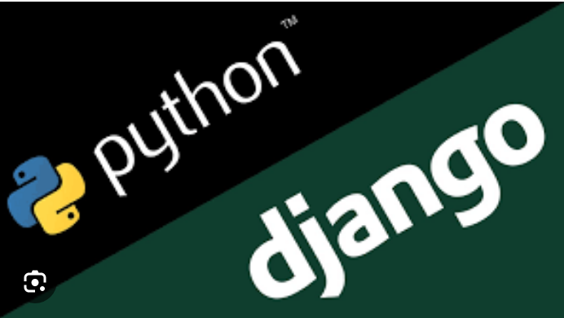
Technology Used
Front-end
Back-end
Source :

Slide 10
Modelling & Results
Modelling:
Bus Company:
Attributes: Name, Contact Information, Location
Bus:
Attributes: Company (ForeignKey to Bus Company), Bus Number, Capacity
Route:
Attributes: Source, Destination, Distance, Duration
Schedule:
Attributes: Bus (ForeignKey to Bus), Route (ForeignKey to Route), Departure Time, Arrival Time
Reservation:
Attributes: Schedule (ForeignKey to Schedule), Passenger Name, Seat Number, Status (Booked, Cancelled, etc.)
Results:
Once you have implemented these models and set up your Django project, you would be able to perform various operations such as:
Adding bus companies, buses, routes, schedules, and reservations through Django admin or custom forms.
Querying and filtering data to display available buses, routes, and schedules to users.
Allowing users to make reservations, cancel reservations, and view their reservation details.
Generating reports on reservations, bus occupancy, revenue, etc.
Source :

Slide 11
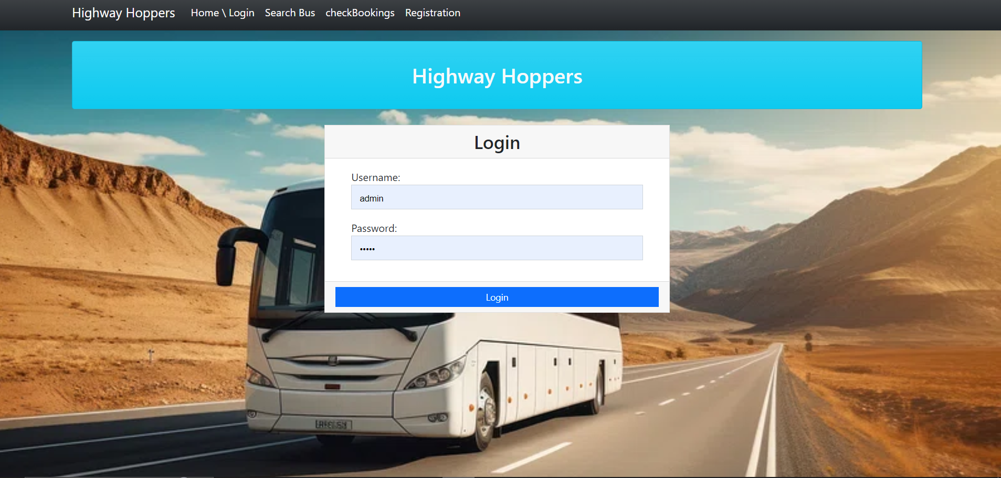
Homepage

Slide 12
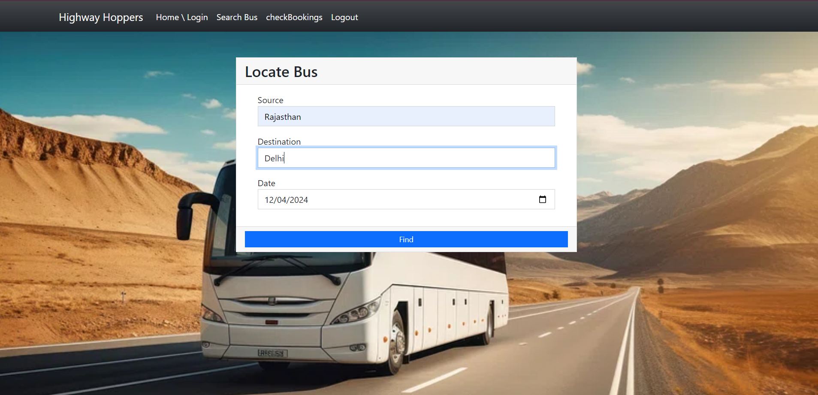
Service-Page

Slide 13
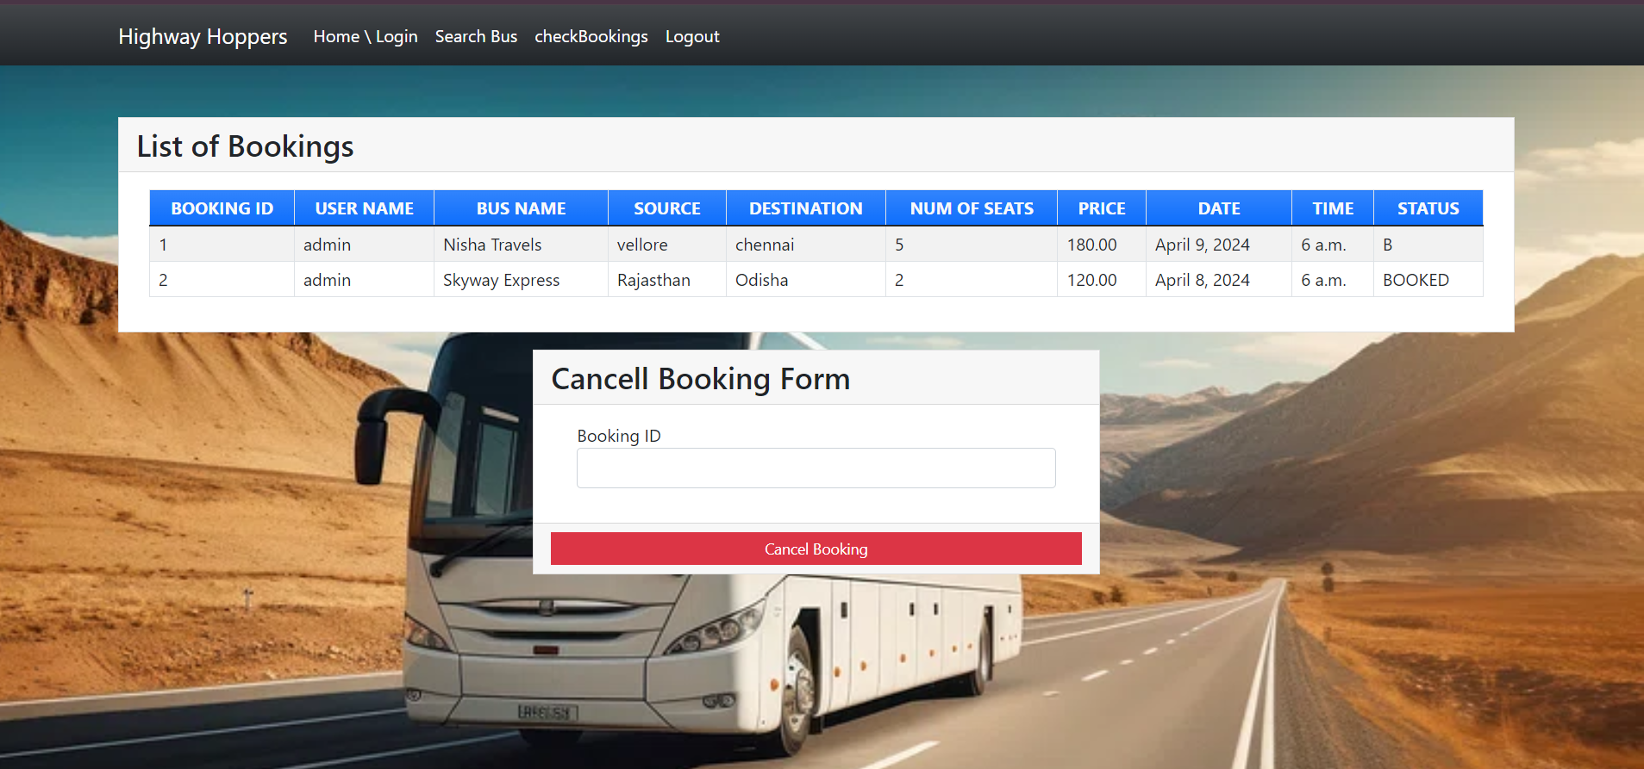
Blog-Page

Slide 14
Future Enhancements:
One future enhancement for a Bus Reservation System built using Python and Django could be the implementation of a real-time tracking feature.
1. GPS Integration : Integrate GPS tracking devices into each bus in the fleet. These devices would continuously transmit the bus's current location data to the server.
2. Passenger Interface : Develop a user interface within the reservation system where passengers can enter their reservation details (such as booking ID or ticket number) to access the real-time tracking information for their specific bus.
3. Real-Time Map Display : Implement a real-time map display on the passenger interface that shows the current location of the passenger's bus along its route. This map could be interactive, allowing passengers to zoom in/out and view additional details such as upcoming stops or estimated arrival times.
4. Notifications : Provide notifications to passengers regarding important updates, such as delays, route changes, or estimated arrival times based on current traffic conditions. These notifications could be sent via SMS, email, or through the reservation system's messaging feature.
5. Driver Interface : Develop a separate interface for bus drivers to view their assigned route, current location, and any relevant updates or instructions from the transportation company.
6. Administrative Dashboard : Create an administrative dashboard for transportation company staff to monitor the overall performance of the real-time tracking system, view analytics, and manage any technical issues or updates related to GPS devices or server infrastructure.
By implementing real-time tracking, passengers would have greater visibility and control over their travel experience, leading to increased customer satisfaction and loyalty. Additionally, transportation companies could use the data collected from GPS tracking to optimize routes, improve scheduling accuracy, and enhance overall operational efficiency.

Slide 15
Conclusion
Building a Bus Reservation System using Python and Django offers a powerful and efficient solution for managing bus ticket bookings and operations. Throughout the development process, we've leveraged the robust features of Django, such as its built-in authentication system, ORM for database management, and powerful templating engine.
By employing Python's simplicity and readability, combined with Django's MVC architecture, we've created a scalable and customizable web application capable of handling various aspects of bus reservation, including user authentication, searching for available buses, booking tickets, and viewing reservations.
Furthermore, the utilization of modern technologies such as Bootstrap for front-end styling and JavaScript for dynamic interactions enhances the user experience and ensures the system is both functional and aesthetically pleasing.
Overall, the Bus Reservation System demonstrates the effectiveness of Python and Django in developing sophisticated web applications that meet the needs of businesses in the transportation sector, providing a seamless booking experience for passengers while streamlining administrative tasks for bus operators.
Source :

Slide 16
Thank You!
Notes:
Thank You !!

